Slide 1


MBD | Analytics for Retail & Consumer
Supply-chain system optimization leveraging demand forecasting
B. Pardo Álvarez | K. van Cauwenberge | D. Dias da Costa | M. Ehmann | C. Kröger | F. Krüger | J. Oldorf | C. Utendorf
Tuesday, June 4th 2019

Slide 2





Today, we will demonstrate how AFR can leverage on demand forecasting to improve its operational efficiency and boost the company’s profitability
Background
p. 3 - 4
Company overview
Project expectations
Situational Analysis
p. 5 - 7
Supply-chain
Pain points
KPIs
Solution space
p. 8 - 14
Methodology
Benefits
Further improvements
Proposal
p. 15 - 16

Slide 3









AFR active in kids fashion market with production facilities in CN, TR & PT – increasing competition leading to significant price pressure
Background
Client snapshot
Operations overview
Environment
Chic-style kids fashion
Design
Centralized fashion design in Spain
Production (outsourced)
Production facilities in CN, TR and PT with varying lead times / variable prod. costs
Design
Distribution
Sale
Portfolio of >1000 different products per season – wide selection of products to specifically meet demands of each addressed age group
100 stores in Spain (ca. 70% of sales), multi-brand stores and online (ca. 30%)¹⁾
Historically high-margin business currently bruised – sales stable
Warehouse storage
Centralized storage of all produced items in ES before distribution
Distribution
External company distributes items to stores
Increasing competition imitating AFR’s strategy and product – mostly at lower prices
With sales down, AFR was forced to reduce prices, resulting in significantly lower margins – sales stabilized
Sale
Online¹⁾ and POS sale in 100 stores
1) Assumption

Slide 4


AFR’s operational inefficiencies and margin pressure require quick and decisive counteraction with regard to improved demand forecasting
Project scope
EXTERNAL
SCOPE
Increasing competitive environment
Fast changing trends in fashion industry
( )
PROJECT SCOPE
INTERNAL
WHAT
Supply-chain and production optimization through improved demand forecasting
Mismatch of supply and demand
Margin pressure due to high operational cost
HOW
Enhanced prediction methodology leveraging AFR’s data and production systems
KEY CHALLENGES

Slide 5


To assess relevant levers for AFR’s operational efficiency, a clear understanding of the company’s supply and value chain is essential
Supply chain, exemplary seasonal planning
Illustrative
2019
2020
2021
Pain Points
Jan
Feb
Mar
Apr
May
Jun
Jul
Aug
Sep
Oct
Nov
Dec
Jan
Feb
Mar
Apr
May
Jun
Jul
Aug
Sep
Oct
Nov
Dec
Jan
Design
Design
Pre season production starts before any sale has occurred
A
Sell-In
Sell-In
Spring / Summer
A
Production
Production
C
Production
B
Produced clothes from China need to be stored until sold
Shipping
B
Ship.
Sale
%
C
In-season production can only be delivered with time lag
Des.
Design
Sell-In
Sell-In
Fall / Winter
Production
Production
Production
Production
Challenge
Shipping
Shipping
Long product lead times meeting very short product life cycles – high demand uncertainty
Sale
%
Sale
%
Source: McKinsey & Company, AFR as European hybrid fashion brand

Slide 6
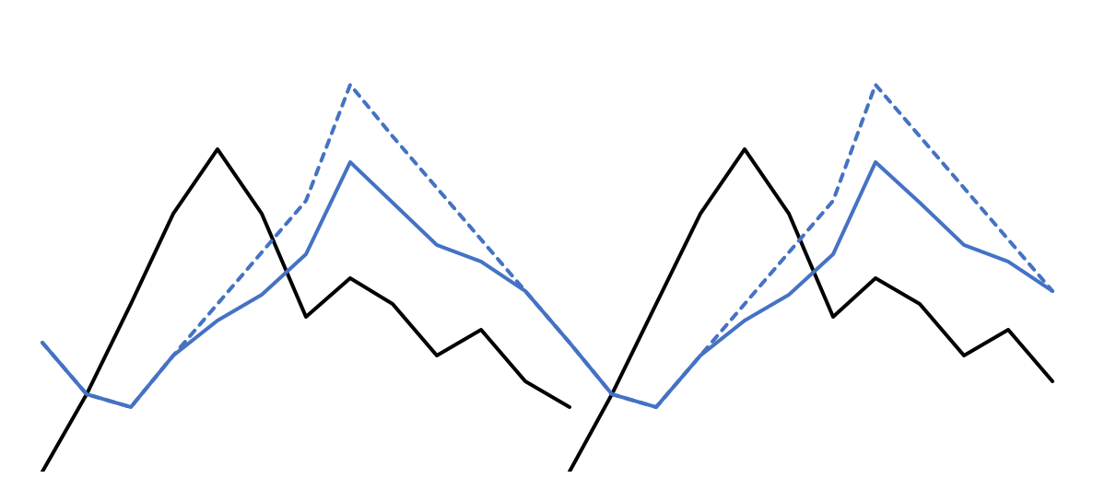
Through long lead times combined with short product life cycles there is a constant mismatch of product supply and demand
Supply and demand mismatch
Illustrative
AFR’s annual sales cycle
Pain Points
Stock Level
Sales Level
A
Forecast errors leading to supply mismatches
B
Stock-outs happen and cannibalize potential sales
C
Unsold stock deteriorates company profitability
Affected KPIs
Forecast error
Stock to sales
Perfect order performance
Contribution margin
Stock peak
Sales peak
Sales
discount
Stock peak
Sales peak
Sales
discount
Stock build-up
Sales
Stock build-up
Sales
1
2
3
4
5
6
7
8
9
10
11
12

Slide 7
Through long lead times combined with short product life cycles there is a constant mismatch of product supply and demand
Supply and demand mismatch
Illustrative
AFR’s annual sales cycle
Pain Points
Stock Level
Sales Level
A
Forecast errors leading to supply mismatches
B
Stock-outs happen and cannibalize potential sales
C
Unsold stock deteriorates company profitability
Affected KPIs
Forecast error
Stock to sales
Perfect order performance
Contribution margin
Stock peak
Sales peak
Sales
discount
Stock peak
Sales peak
Sales
discount
Stock build-up
Sales
Stock build-up
Sales
1
2
3
4
5
6
7
8
9
10
11
12

Slide 8
Through long lead times combined with short product life cycles there is a constant mismatch of product supply and demand
Supply and demand mismatch
Illustrative
AFR’s annual sales cycle
Pain Points
Stock Level
Sales Level
A
Forecast errors leading to supply mismatches
A
A
B
Stock-outs happen and cannibalize potential sales
C
Unsold stock deteriorates company profitability
Affected KPIs
Forecast error
Stock to sales
Perfect order performance
Contribution margin
Stock peak
Sales peak
Sales
discount
Stock peak
Sales peak
Sales
discount
Stock build-up
Sales
Stock build-up
Sales
1
2
3
4
5
6
7
8
9
10
11
12

Slide 9
Through long lead times combined with short product life cycles there is a constant mismatch of product supply and demand
Supply and demand mismatch
Illustrative
AFR’s annual sales cycle
Pain Points
Stock Level
Sales Level
A
Forecast errors leading to supply mismatches
A
A
B
B
B
Stock-outs happen and cannibalize potential sales
C
Unsold stock deteriorates company profitability
Affected KPIs
Forecast error
Stock to sales
Perfect order performance
Contribution margin
Stock peak
Sales peak
Sales
discount
Stock peak
Sales peak
Sales
discount
Stock build-up
Sales
Stock build-up
Sales
1
2
3
4
5
6
7
8
9
10
11
12

Slide 10
Through long lead times combined with short product life cycles there is a constant mismatch of product supply and demand
Supply and demand mismatch
Illustrative
AFR’s annual sales cycle
Pain Points
Stock Level
Sales Level
A
Forecast errors leading to supply mismatches
A
A
B
B
B
Stock-outs happen and cannibalize potential sales
C
Unsold stock deteriorates company profitability
Affected KPIs
Forecast error
Stock to sales
Perfect order performance
Contribution margin
C
C
Stock peak
Sales peak
Sales
discount
Stock peak
Sales peak
Sales
discount
Stock build-up
Sales
Stock build-up
Sales
1
2
3
4
5
6
7
8
9
10
11
12

Slide 11
Forecast accuracy directly and indirectly impacts several KPIs – improving it could lead to significant positive business development for AFR
KPI landscape
Direct impact
Stock to sales
Perfect order performance
Avg. contribution margin
Forecast accuracy
Measures the ratio of inventory available versus quantity actually sold
Indicates stocking effectiveness and should be kept as low as possible
POP = % delivered on time *
% complete *
% damage free *
% accurate doc.
Key indicator measuring delivery effectiveness
Measuring profitability per product group
Indicating production / assortment cost management effectiveness
Measures deviation of actual to planned sales by SKU, tracked daily/ weekly
Key indicator of inventory management effectiveness
Basis of demand prediction KPI landscape
Indirect impact
Net promoter score
Others
Measures customer satisfaction / referral likelihood
Customer retention
Service level

Slide 12






Due to varying data availability and differing production cycles, three different forecasting models are suggested to optimize supply chain management
Methodology overview
Pre-season forecast
3
In-season forecast
Order
size
Sales
Basic items
sold each year
(minimal adjustments)
Fashion items
changing every season adapted to fashion trends
1
2
Forecasts for
production plan
Total quantity
per SKU
for season
Pre season production
Mid-term production
Short-term production
Pre season – no season sales have occurred yet
In season – season sale has stared
Time

Slide 13


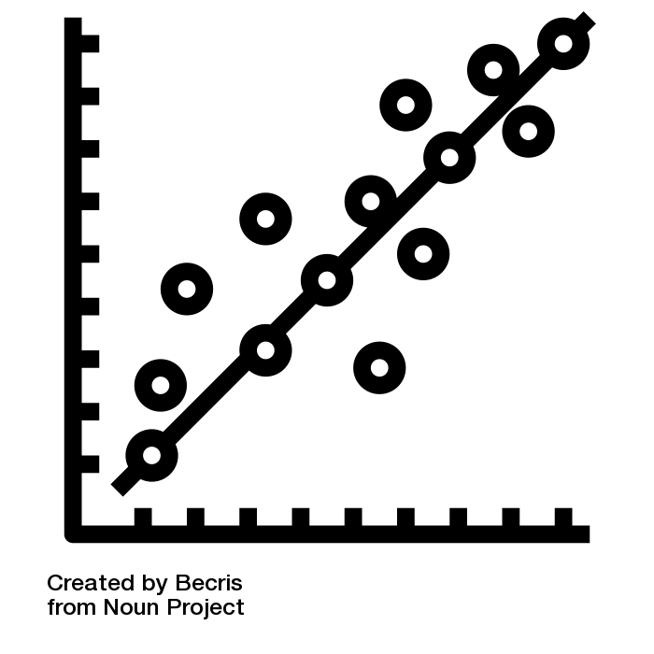




Pre-season basics forecasting model will leverage historic sales data and provide demand prediction on SKU level
Pre-Season
Basics
1
Pre-season, basics demand forecasting methodology
Input
Model
Output
Historic Sales
Linear Regression
with Lagged
Time Variable
SKU Demand
for entire season
COLLECTION
ARTICLE
MARKET
FAMILY
COLOR
BRAND
STYLE
SIZE
Aggregation Level of SKU
Demographics
Illustrative Output:
SKU1 (Girls, Casual, Jeans, id1, Red, M): 5.000 units
Consecutive steps
Business
approval
PUSH
Production Order
for China
Output

Slide 14

Due to lack of historic sales data, forecasts can be only on family level but combined with business expert evaluation for final order
Pre-Season
Fashion
2
Pre-season, fashion demand forecasting methodology
Input
Model
Output
Historic Sales
Linear Regression
with Lagged
Time Variable
Family level forecast
for entire season
COLLECTION
ARTICLE
MARKET
FAMILY
COLOR
BRAND
STYLE
SIZE
Aggregation Level of SKU
Marketing Activities
Illustrative Output:
Family 1 (Girls, Casual, Jeans): 20.000 units
Consecutive steps
Article level
fashion expert
Evaluation &
3rd party orders
Size
demographic
distribution
SKU level
Order based on
forecast and eval.
PUSH
Production order
for China
Output
Family level

Slide 15


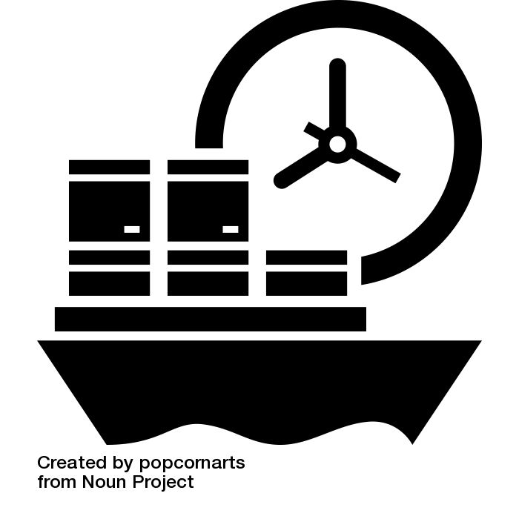


Replenishment based on in-season forecast leveraging sales information on single-store basis
In-Season
3
In-season forecast methodology – Store specific models
Input
Model
Output
Pre sales
In season store sales
Weather forecast
Upcoming marketing activities
Calendar data
Avg last year family sales
Influencer coverage
Daily and weekly quantity
per SKU
per store
Neural Network
Consecutive steps
PULL
2 weeks
Output
Weekly orders
based on forecast
Warehouse
1 week
Stores

Slide 16




Our proposed forecasting methodology will result in strong, positive changes for all focus KPIs
Incremental benefits on focus KPIs
KPI
Change
Description
Example
Forecast accuracy
Leveraging internal and external data using adv. analytics techniques with direct impact on forecast accuracy
Overall deviation between actual and planned demand will decrease both pre- and in-season
Stock to sales
Optimizing inventory levels will ensure minimizing days of under- and overstocking in stores
Especially in more ‘difficult’ planning periods for non-basic products, stocking based on sophisticated planning and not on sporadic purchases is crucial for AFR
Perfect order performance
Improved on-time delivery both in warehouse and in stores will boost perfect order performance
Knowing precisely when and where which items are needed, accurate on-time deliveries to warehouse and stores increase
Contribution margin
Optimizing balanced supply from CN, TR and PT lowers assortment costs
In-store storing costs lower due to increasing just-in-time delivery
Produced and stored at lower cost, each item contributes now more positively to AFRs business result
Net promoter score
Increased customer satisfaction ensured due to better product availability, i.e. less stockouts
Customers are more likely to give positive feedback or referrals about AFR having experienced a positive (e.g. non-stockout) AFR-experience

Slide 17





In the long run AFR will unlock further potential by implementing a more efficient supply chain through data driven automation and decision making
Supply chain optimization
Fully connected supply chain trough information sharing
Digitized value chain
Integrated data streams
Real-time Analytics
Design
Production
Order Fulfilment
Store
On-the-fly prototyping based on direct feedback from in-shop buying patterns
Forecast based raw material sourcing
Pull-based in-season production adjustments
Automized emergency response tool for improved crisis management
Season start stocking based on pre-sales data
Automized ordering process
Adaptive discounting policy

Slide 18
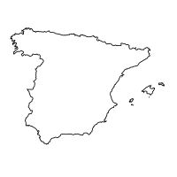

Decision making based on advanced analytics creates value across the supply chain but is only successful if operations adopts accordingly
Example: Leveraging pre-sales data
Pre season sales in selected stores
Warehouse optimizes distribution for season start
Cluster specific stock for season start
Cluster specific forecasts
Distribution
plan
Stores are clustered and for each cluster a store is selected
Pre season sales help to estimate regional specific sales
Warehouse can send out initial stock based on pre sales experience

Slide 19
Due to the high complexity of a fashion retailer supply chain the adoption of the new forecasting models should be based on experiences from pilot runs
Action Plan
Timeline
Resource requirements¹⁾
Jun
Jul
Aug
Sep
Oct
Nov
Dec
Data engineer
Data scientist
Business Translator
1
Status quo &
stakeholder analysis
4 weeks
2
Data collection &
consolidation
4 weeks
3
Model design &
setup
3 weeks
4
Pilot run
8 weeks
5
Evaluation &
adjustments
3 weeks
6
Roll out
10 weeks
1) Workload:
High
Mid
Low

Slide 20
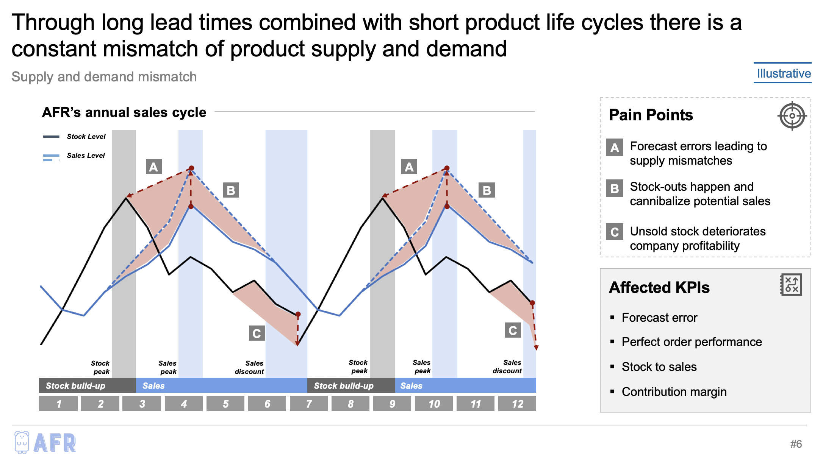
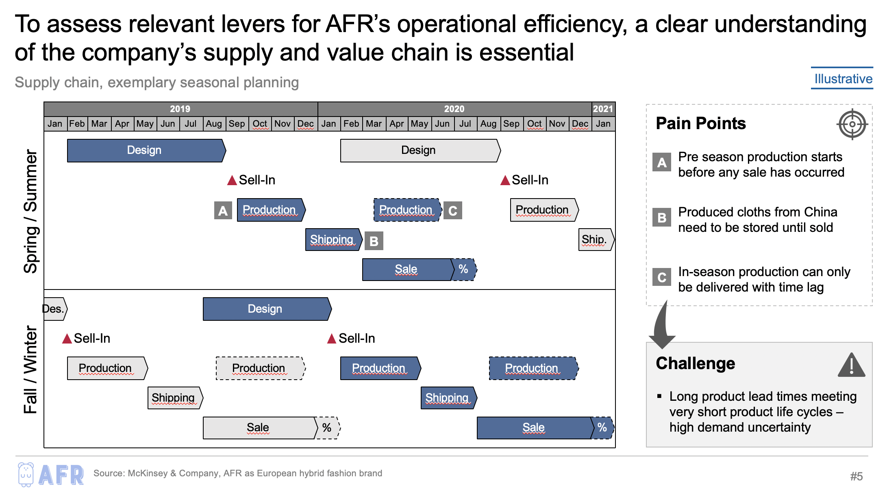
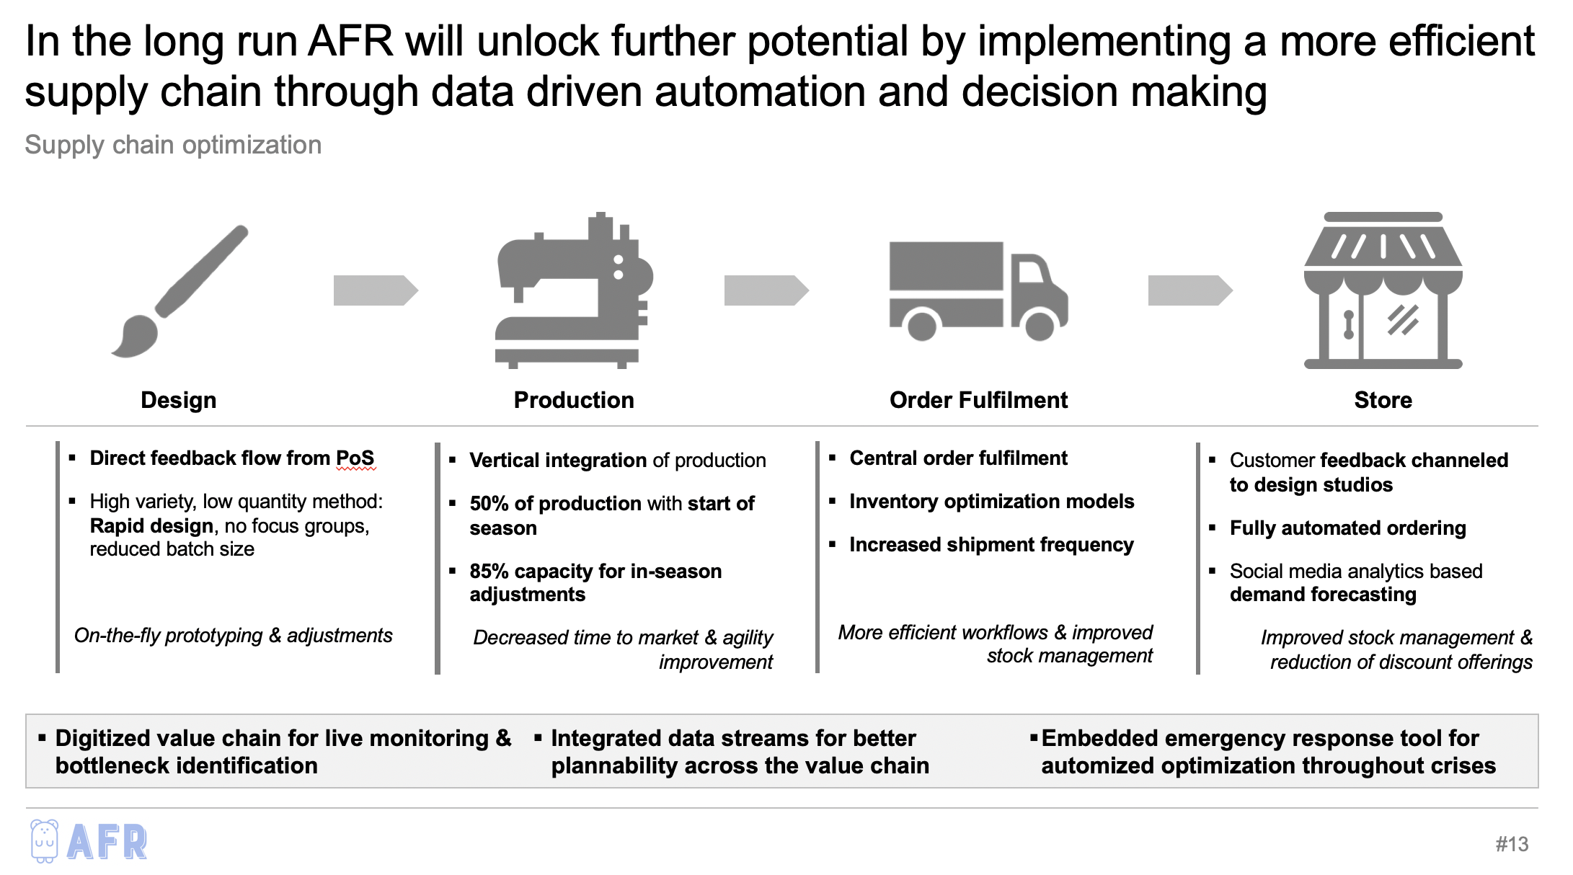
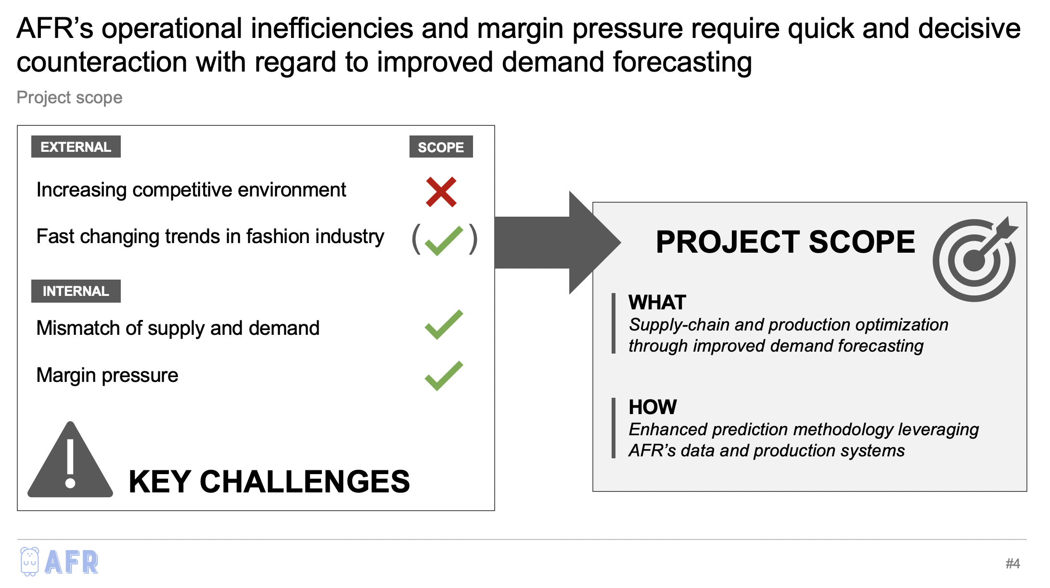
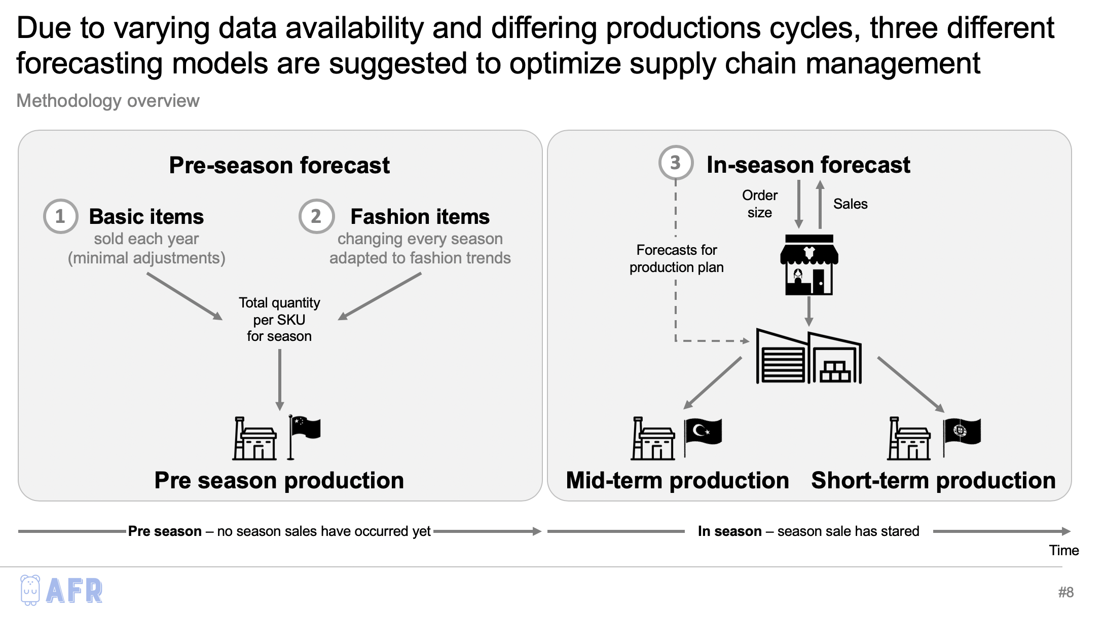
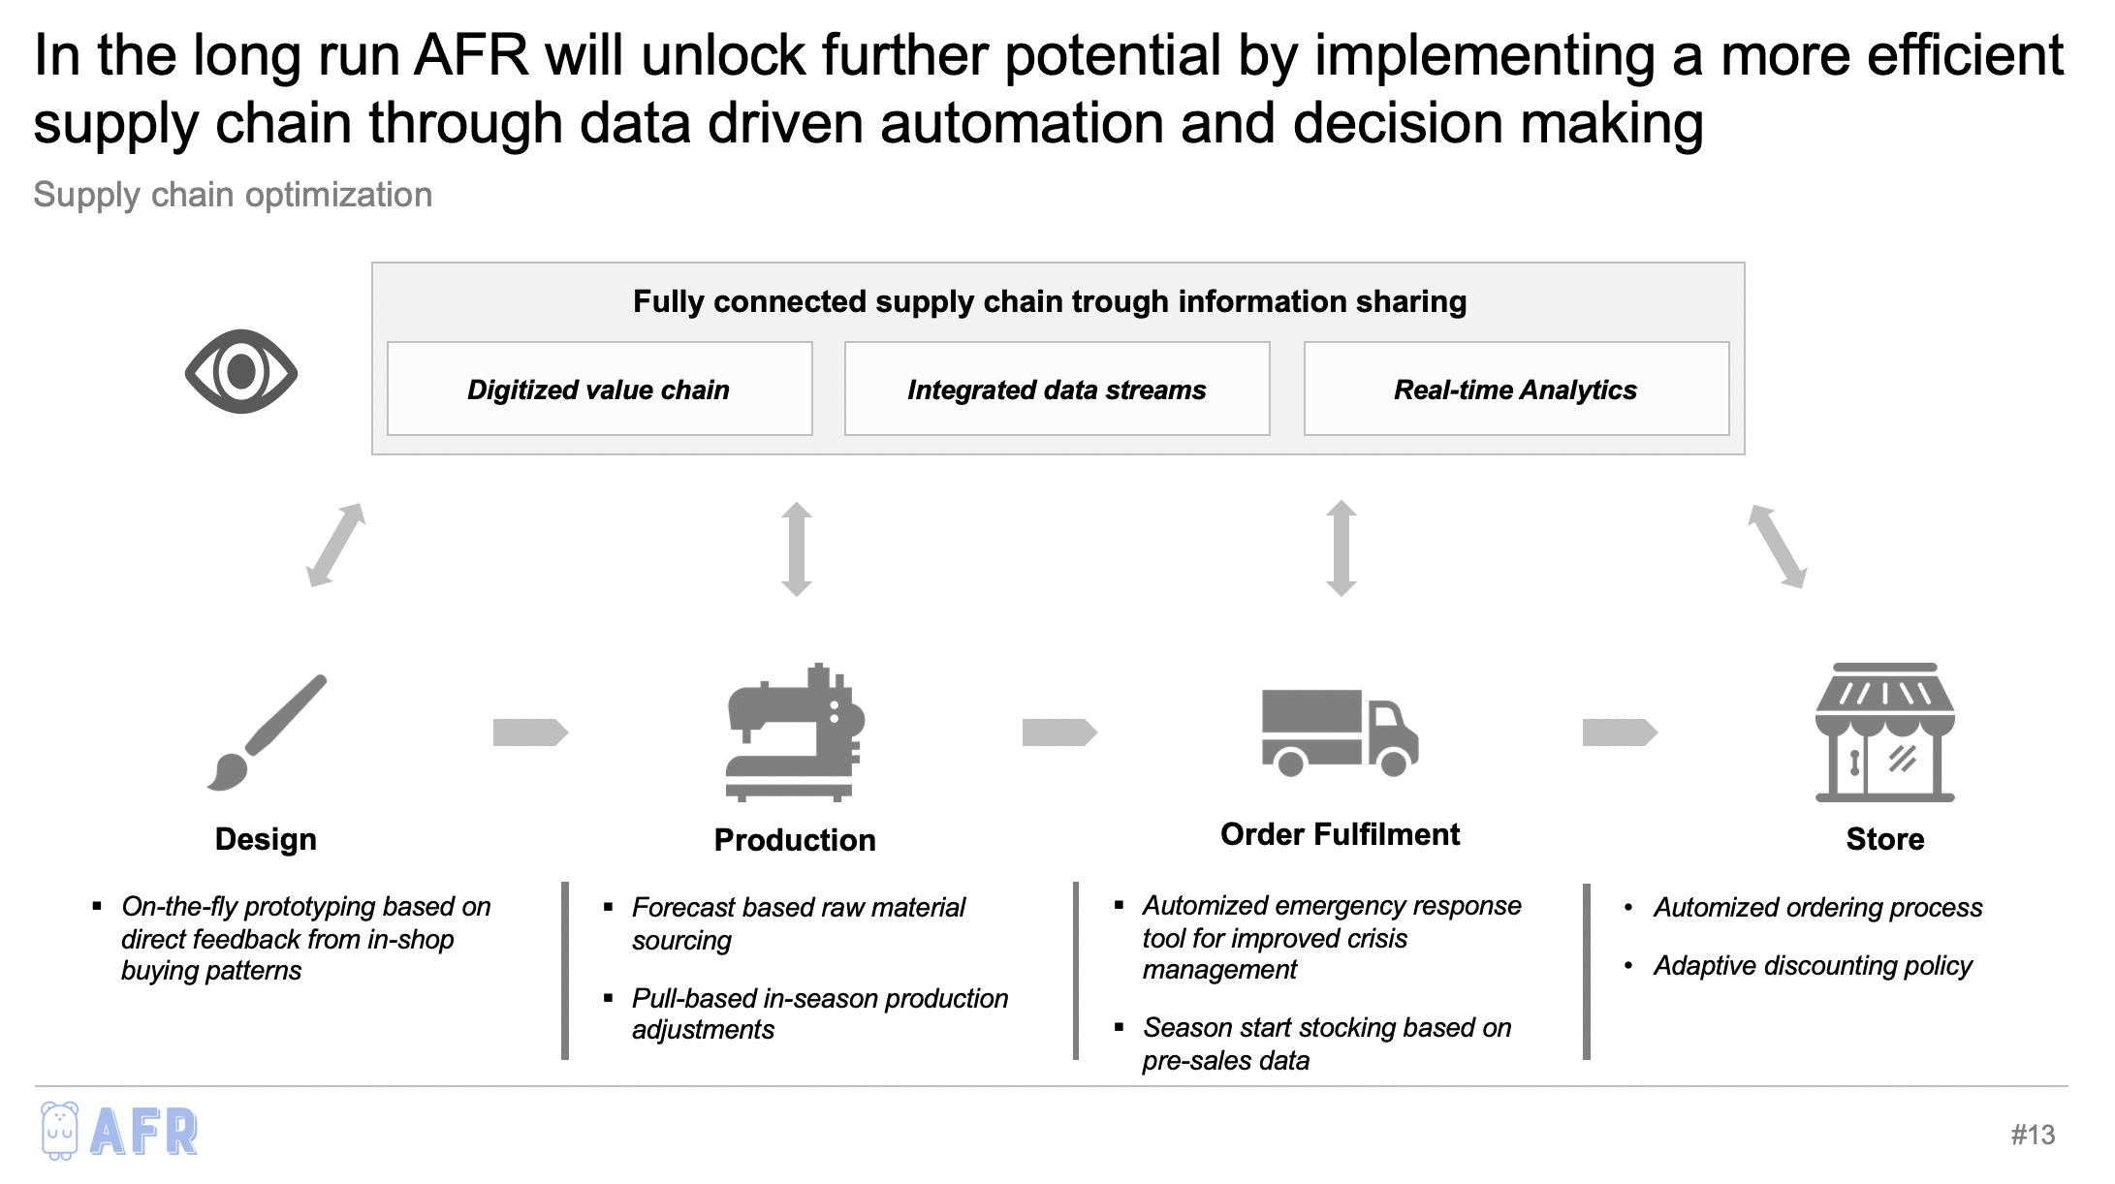
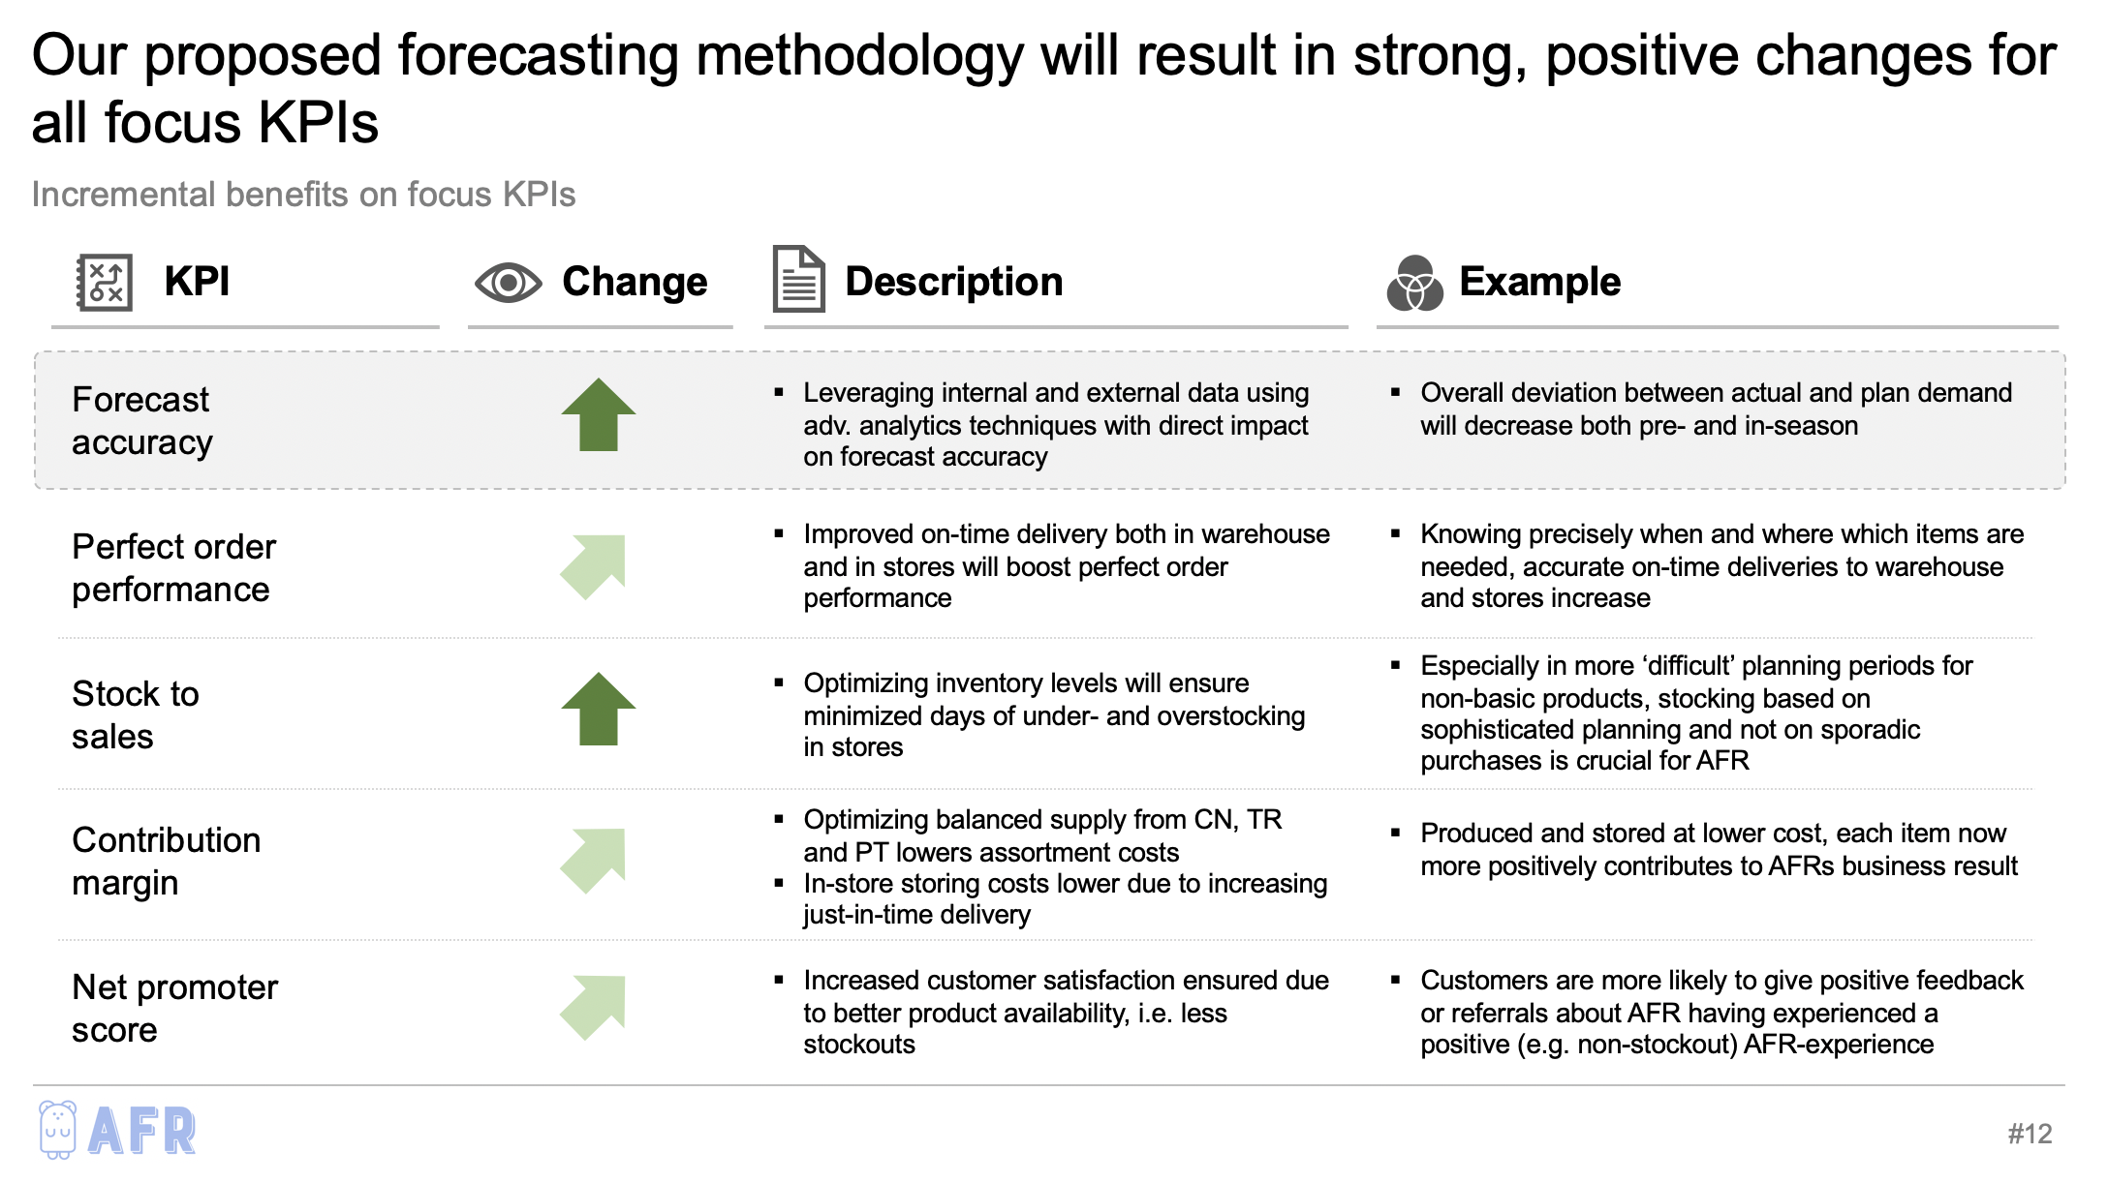
SCM based on advanced analytics does not only provide incremental benefits but also helps to cope the high demand uncertainty within the fashion industry
Conclusion
Status Quo
Proposed Methodology
Expected results
Insufficient SCM resulting in constant mismatch of supply and demand, leading to an increasing supply chain cost and margin pressure
Reducing forecast error and thus optimizing replenishment management, reducing operational cost through a more efficient supply chain
Proposed forecasting methodology will result in strong, positive changes for all focus KPIs – additional SCM innovations will further boost AFR’s long-term business performance

Slide 21
MBD | Analytics for Retail & Consumer
Thank you for your attention.
B. Pardo Álvarez | K. van Cauwenberge | D. Dias da Costa | M. Ehmann | C. Kröger | F. Krüger | J. Oldorf | C. Utendorf
Tuesday, June 4th 2019

Slide 22
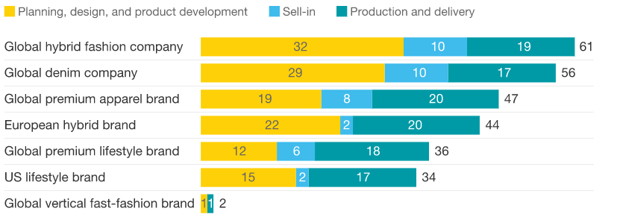
Fashion cycle duration varies across industry due to different company profiles and production line set-ups
Overview pre season planning (in weeks)
Source: McKinsey and Company

Slide 23


AFR three different production sites in China, Turkey and Portugal differ in production cost and delivery times
Production site overview
Average production cost
Arrival time
CN
8 USD
36 days shipping
+ 4 days customs
TK
16 USD
12 – 28 days shipping
6 – 8 days plane
PT
24 USD
6 days road delivery
Source: Made in China, DSV logistics, Me360, Freigthos

Slide 24


AFR builds on a sophisticated operational data management system but is not yet leveraging on its full potential
Data management
A
Internal data sources
External data sources
B
Description
Pain Points
A
Historical sales and stock data, promotional data
Sole data source for replenishment planning
C
Data management
B
E.g. weather, holiday, competitor data, social media data
External data not at all leveraged
C
Data aggregation and flow between central and decentral stakeholders
Infrequent communication between warehouse & stores
D
Replenishment planning based on steps A-C
No algorithmic replenishment planning in place
D
Replenishment planning

Slide 25
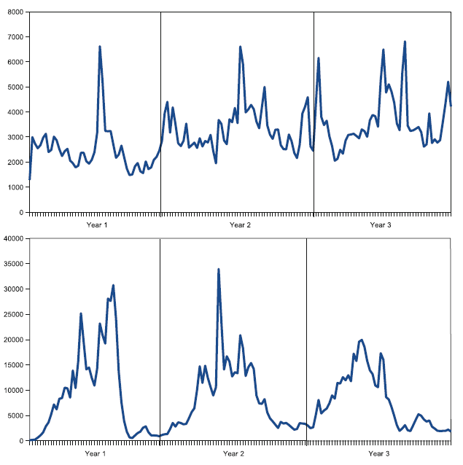
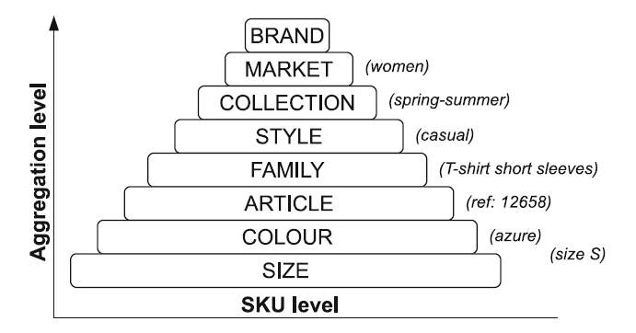
Among fashion item groups differing seasonal variation levels due to group specific sensitivities and sales patterns
Aggregation levels of fashion products
Underpants sales
(Underpants)
FAMILY
Short sleeves t-shirts sales
Source: Sebastian Thomassey

Slide 26
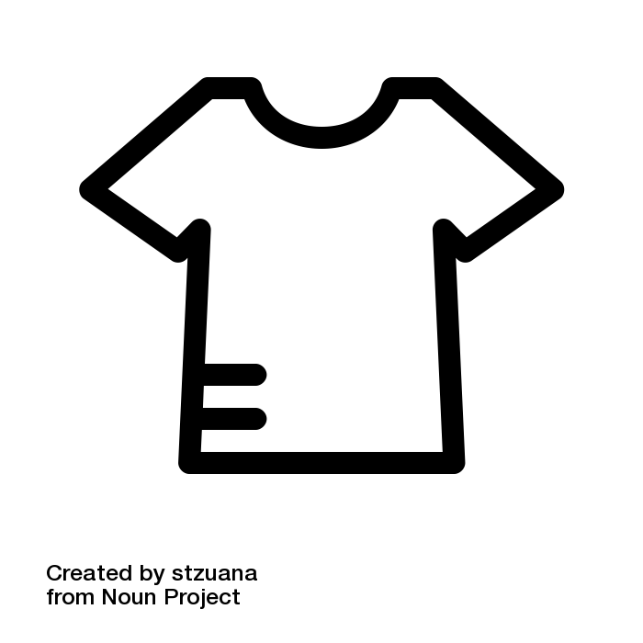

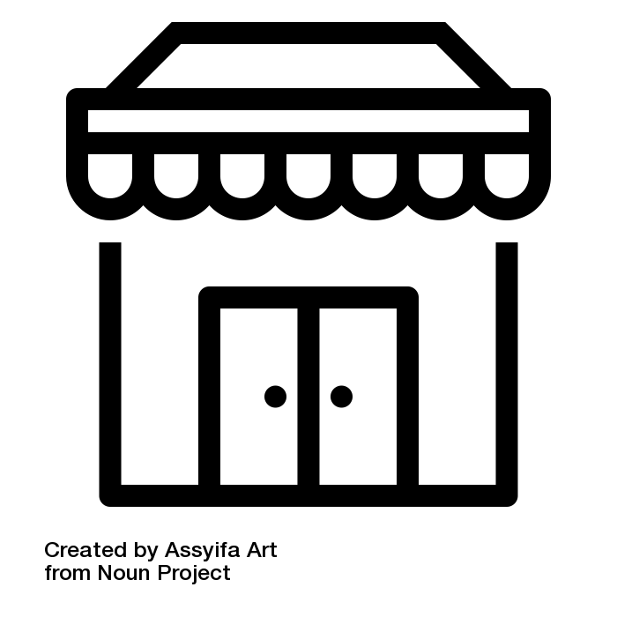




Fashion demand is influenced by several different factors – some of them can be influenced by the retailer while others cannot and are also difficult to predict
Demand influence factors
Under control
Uncontrolled
Item features
(size, colour, style,…)
Weather data
(temp, rainfall,…)
Retailing strategy
(number of stores, location,…)
Competition
(offer, promos,…)
Marketing strategy
(advertising,…)
Calendar data
(holidays,…)
Economic trends
(purchasing power,…)
( )
Observable
Not observable
Source: Sebastian Thomassey

Slide 27
Machine learning model with lagged time variables takes advantage
of historic sales data as well as demographic trends among Spain
Linear model with lagged time variables – Pre season Basics
Illustrative
 | Historical Data
 | Total qty sold Y-1 | Total qty sold Y-2
SKU 1-2011 | 23 500 | 26 000
SKU 1-2012 | 25 000 | 23 500
SKU 1-2013 | 23 500 | 25 000
SKU 1-2014 | 24 500 | 23 500
SKU 1-2015 | 25 500 | 24 500
… | … | …
SKU 1-2018 | 25 200 | 24 700
SKU 1-2019 | 26 000 | 25 300
Demographics
# of children 0-3 mnths Y-1 | #of children 0-3 mnths Y-2 | … | # of children 11-12 yrs Y-1 | # of children 11-12 yrs Y-2
# | # | … | # | #
# | # | … | # | #
# | # | … | # | #
# | # | … | # | #
# | # | … | # | #
… | … | … | … | …
# | # | … | # | #
# | # | … | # | #
Target
Total quantity
25 000
23 500
24 500
25 500
24 000
…
26 000
?
Clarifications:
Values displayed in this tables need to be processed before inputting them in the model
Depicted values represent aggregated data from previous seasons, not full years’ data
Demographics features presented above are for a generic case. For a specific SKU ONLY certain age ranges will apply, since a specific SKU by definition will suit to certain ages

Slide 28
We will implement our solution in less then 8 mo. with skill sets comprising Data Engineering & Science and Business Translator capabilities for less than 600k
Commercial proposal
Resource requirements
Commercial Proposal (k EUR)
Workload
Data engineer
Data scientist
Business Translator
Data engineer
Data scientist
Business Translator
TOTAL
Low
0-1 FTE
1
Status quo &
stakeholder analysis
12 | 8 | 30 | 50
20 | 8 | 6 | 34
3 | 30 | 4.5 | 37.5
24 | 80 | 60 | 164
15 | 30 | 22.5 | 67.5
30 | 100 | 75 | 205
4 weeks
Mid
1-2 FTE
2
High
2-3 FTE
Data collection
& consolidation
4 weeks
Rates
3
Model design &
setup
3 weeks
Data Engineer
2000 EUR
Data Scientist
4000 EUR
4
Pilot run
8 weeks
Business Translator
3000 EUR
5
Evaluation &
adjustments
3 weeks
TOTAL (k EUR)
6
Roll out
10 weeks
Full-fledged project
558.000

Slide 29
Academic resources as well as operational experts are constantly discussing how to optimize supply chains in the fashion industry
Sources (1/2)
Berg, A.; Heyn, M.; Rölkens, F.; Simon, P. (2019, May 23). Faster fashion: How to shorten the apparel calendar. Retrieved from
https://www.mckinsey.com/industries/retail/our-insights/faster-fashion-how-to-shorten-the-apparel-calendar
Choi, T. M.; Hui, C. L.; Yong, Y. (2014). Intelligent fashion forecasting systems : models and applications.
Heidelberg New York: Springer.
Digital Supply Networks (2019, May23). D!gitalist Magazine. Retrieved from
https://www.digitalistmag.com/digital-supply-networks/2016/03/30/zaras-agile-supply-chain-is-source-of-competitive-
advantage-04083335
DSV (2019, May 17). Global Transport and Logistics. Retrieved from
http://www.es.dsv.com/transporte-mercancias-ferrocarril/importacion-exportacion-china/tiempos-transito
Freightos.com (2019, May 15). Freight Shipping and Transit Calculator. Retrieved from
https://www.freightos.com/freight-resources/transit-time-calculator-for-international-freight-free/
Gorrepati, K. (2019, May 23). D!gitalist Magazine. Retrieved from
https://www.digitalistmag.com/digital-supply-networks/2016/03/30/zaras-agile-supply-chain-is-source-of-
competitive-advantage-04083335

Slide 30
Academic resources as well as operational experts are constantly discussing how to optimize supply chains in the fashion industry
Sources (2/2)
Made-in-China.com (2019, May 10). Connecting Buyers with Chinese Suppliers. Retrieved from
https://www.made-in-china.com/productdirectory.do?word=clothes&subaction=hunt&style=b&mode=and&code=0&com
Province=nolimit&order=0&isOpenCorrection=1
Me360.com (2019, May 15). 土耳其纺织行业概况. Retrieved from
http://www.me360.com/article/330433
Peneházi, G. (2019). Recurrent Neural Network for Time Series Forecasting. University of Debrecen,
Doctoral School of Mathematical and Computational Sciences
tradegecko.com (2019, May 18). Zara supply chain analysis. Retrieved from
https://www.tradegecko.com/blog/zara-supply-chain-its-secret-to-retail-success
TrendReports (2019, May 25). Kids Fashion Trend Report. Retrieved from
https://www.trendreports.com/research/kids-fashion-trend-report

